Slide 1

We’ve already talked about value of $\frac{3}{2}RT$ at room temperature
$$\frac{3}{2}RT= \frac{3}{2} × 8.314\frac{J}{mol K}× 298 K$$
$≈4000\frac{J}{mol}$ = $4\frac{kJ}{mol}$

Slide 2
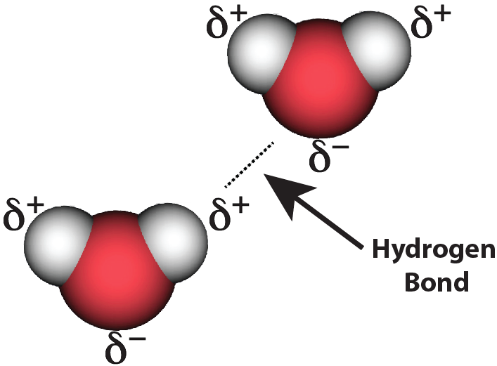
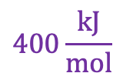
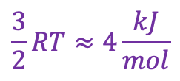
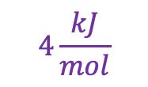
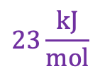
… And of the importance of the fact that $\frac{3}{2}RT=4\frac{kJ}{mol}$ (at room T)
Covalent bonds after a collision …
vdw bonds after a collision …
$$400\frac{kJ}{mol}$$
C
C
$$23\frac{kJ}{mol}$$
$$4\frac{kJ}{mol}$$
$$\frac{3}{2}RT≈4\frac{kJ}{mol}$$
N
N
N
N

Slide 3
… And of the importance of the fact that $\frac{3}{2}RT=4\frac{kJ}{mol}$ (at room T)
Covalent bonds after a collision …
… are still intact!
vdw bonds after a collision …
… are likely to be torn asunder
$$400\frac{kJ}{mol}$$
C
C
$$23\frac{kJ}{mol}$$
$$4\frac{kJ}{mol}$$
$$\frac{3}{2}RT≈4\frac{kJ}{mol}$$
N
N
N
N

Slide 4
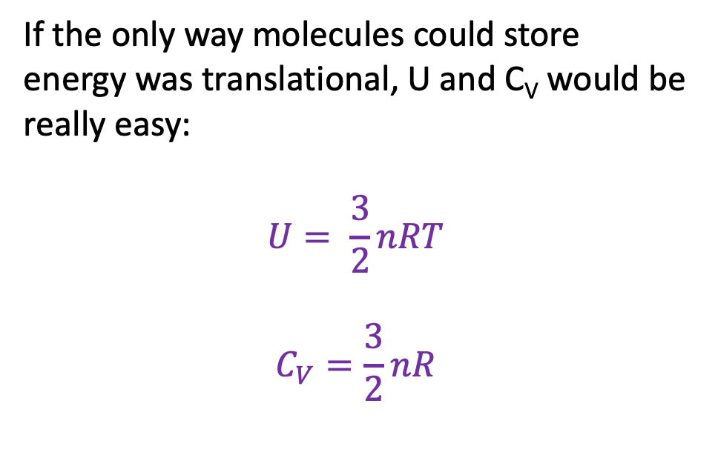
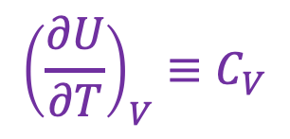
U as a thermodynamic surface
$${\left(\frac{∂U}{∂T}\right)}_{V}≡C_{V}$$
U(T,V)
If the only way molecules could store energy was translational, U and C_{V} would be really easy:
$$U= \frac{3}{2}nRT$$
$$C_{V}=\frac{3}{2}nR$$
V
“State Space”
T
Isochoric heating

